Slide 1


View
Android UI Components
Views · ViewGroups · Layouts

Slide 2





Contents
01
02
Views
A Tree-Structured UI
03
04
Android vs Swing UI
Basic Views
05
Viewgroups

Slide 3

Introduction
1
Basic unit of an Android app is the Activity
(android.app.Activity).
2
An Activity alone has no screen presence.
3
Views and ViewGroups are used to design the UI.

Slide 4
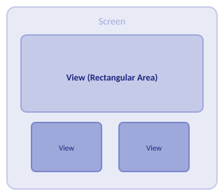
Views
Extends
android.view.View
Stores
Layout & content for a rectangular screen area
Handles
Measuring, drawing, focus, scrolling, gestures

Slide 5
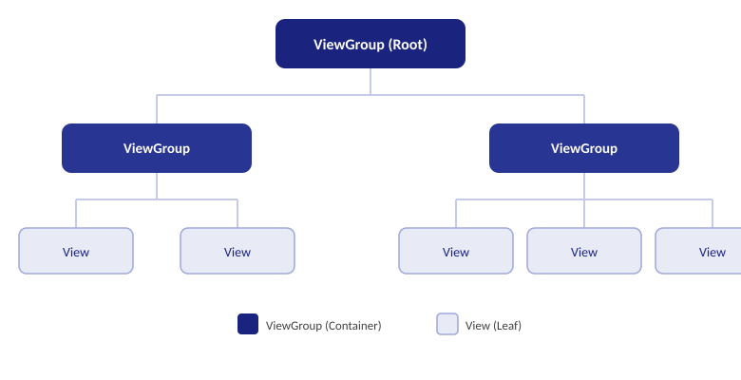
A Tree-Structured UI

Slide 6
Comparing Android UI Elements to Swing UI Elements
Android
Swing (Java)
Activity
→
JFrame
View
→
JComponent
TextView
→
JLabel
EditText
→
JTextField
Button
→
JButton

Slide 7




Basic Views
Basic Views
Picker Views
List Views
TextView, EditText, Button
TimePicker, DatePicker
ListView, Spinner
Display Views
Menus
Additional
Gallery, ImageSwitcher
Context-sensitive menu items
AnalogClock, DigitalClock

Slide 8





Basic Views
TextView
EditText
Display text on screen
Editable text input
Button
ImageButton
Clickable action button
Button with image
CheckBox
ToggleButton
Multiple yes/no selection
On/Off toggle switch
RadioButton
RadioGroup
Single choice selection
Groups radio buttons

Slide 9
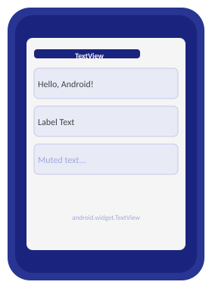
TextView
Draws text
Basic UI control to draw text on screen.
Labels
Used for fixed text strings or labels.
Child control
Embedded within other screen elements.
Package
Derived from View; in android.widget.
Attributes
width, height, padding, visibility.
XML tag
<TextView>

Slide 10
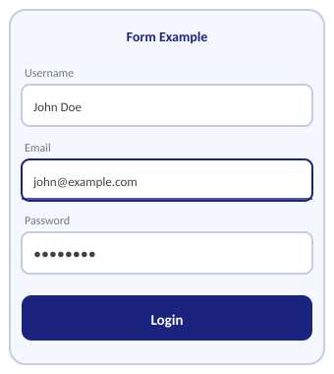
TextView and EditText
TextView displays a text string on screen.
Attributes: height, width, font, text color, background.
EditText is an editable version of TextView.
Accepts user input; used in forms and login screens.

Slide 11
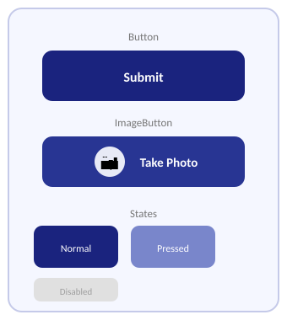
Button and ImageButton
Button — clickable control with a text label.
User taps it to trigger an action.
ImageButton — displays an image instead of text.
Used in visual, mobile-oriented interfaces.

Slide 12
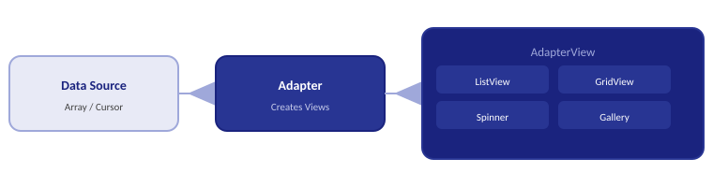
Adapters and AdapterViews
Adapter — takes data and creates Views for display.
AdapterView — displays data provided by an Adapter.
Subclasses: ListView, GridView, Spinner, Gallery.

Slide 13
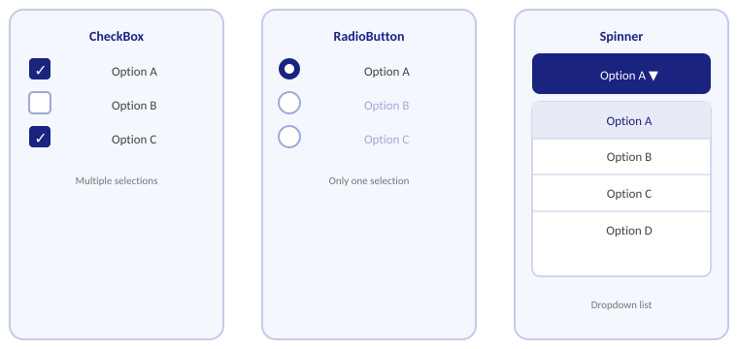
CheckBoxes, RadioButtons, and Spinners

Slide 14
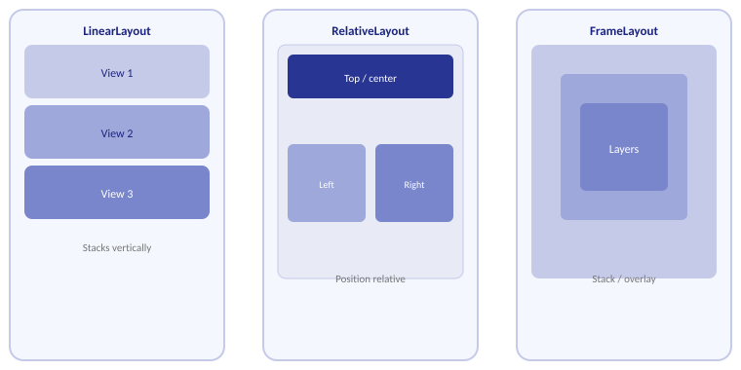
Viewgroups

Slide 15
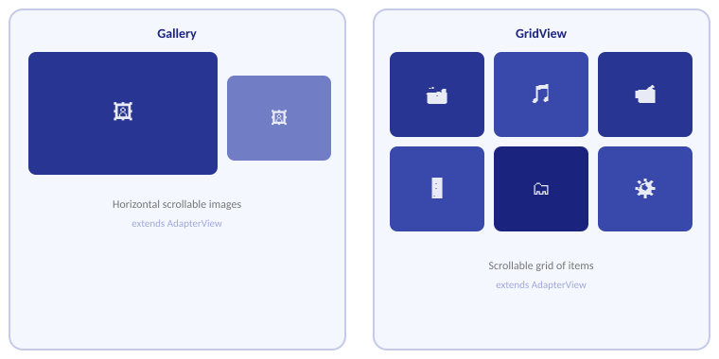
Gallery and GridView

Slide 16

Gallery and GridView
Slideshow
Start a slideshow of gallery images.
New Album
Create a new album.
View by
Filter: All, Device, Facebook, Picasa.
Select Album
Delete, share, or slideshow albums.
Nearby Scan
Share with nearby devices wirelessly.
Hide/Show
Toggle nearby devices' albums.

Slide 17
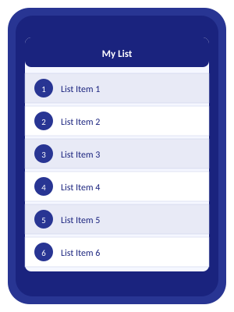
ListView and ListActivity
ListActivity — subclass of Activity with a built-in ListView.
Can connect to arrays or query cursors as data sources.
Displays items as a scrollable list on screen.
Use setListAdapter() with an ArrayAdapter to populate.

Slide 18
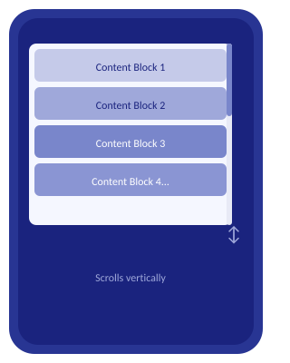
ScrollView
Container that enables vertical scrolling of its child View.
Often wraps a LinearLayout with multiple Views.
Allows any View to scroll vertically.
Avoid placing a ListView inside a ScrollView.

Slide 19
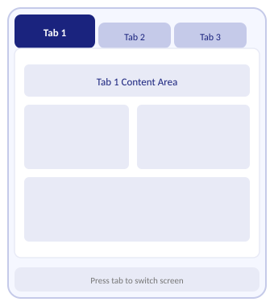
TabHost
Lets users navigate multiple pages using tabs.
Each tab press shows a different screen of content.
• Set content to an Intent.
• Use TabContentFactory (on-the-fly).
• Load from an XML layout file.

Slide 20

Thank you
Android Views & UI Components

